Slide 1


Experimental diachronics: Investigating language change and evolution in the lab
James Brand
j.brand@lancaster.ac.uk

Slide 2
Overview
Experimental diachronics
Outline
What you will learn today:
What language change and evolution is
Why we study it
How to study it
What studying it has shown us
Why multi-disciplinary research is important

Slide 3
Overview
Experimental diachronics
What is language evolution?
Darwin (1837)

Slide 4
Overview
Experimental diachronics
What is language evolution?
Schleicher (1863)

Slide 5
Overview
Experimental diachronics
What is language evolution?
Gray et al., 2010

Slide 6
Motivations
Experimental diachronics
Why study language evolution?
http://www.nytimes.com/2007/11/01/science/01chimp.html
Notes:
Human unique language – no other communication system in animals

Slide 7
Motivations
Experimental diachronics
Why study language evolution?
Rise of the Planet of the Apes (2011)

Slide 8
Motivations
Experimental diachronics
Why study language evolution?
haha
lol
aaaaaa
*grunt*
$%£#

Slide 9
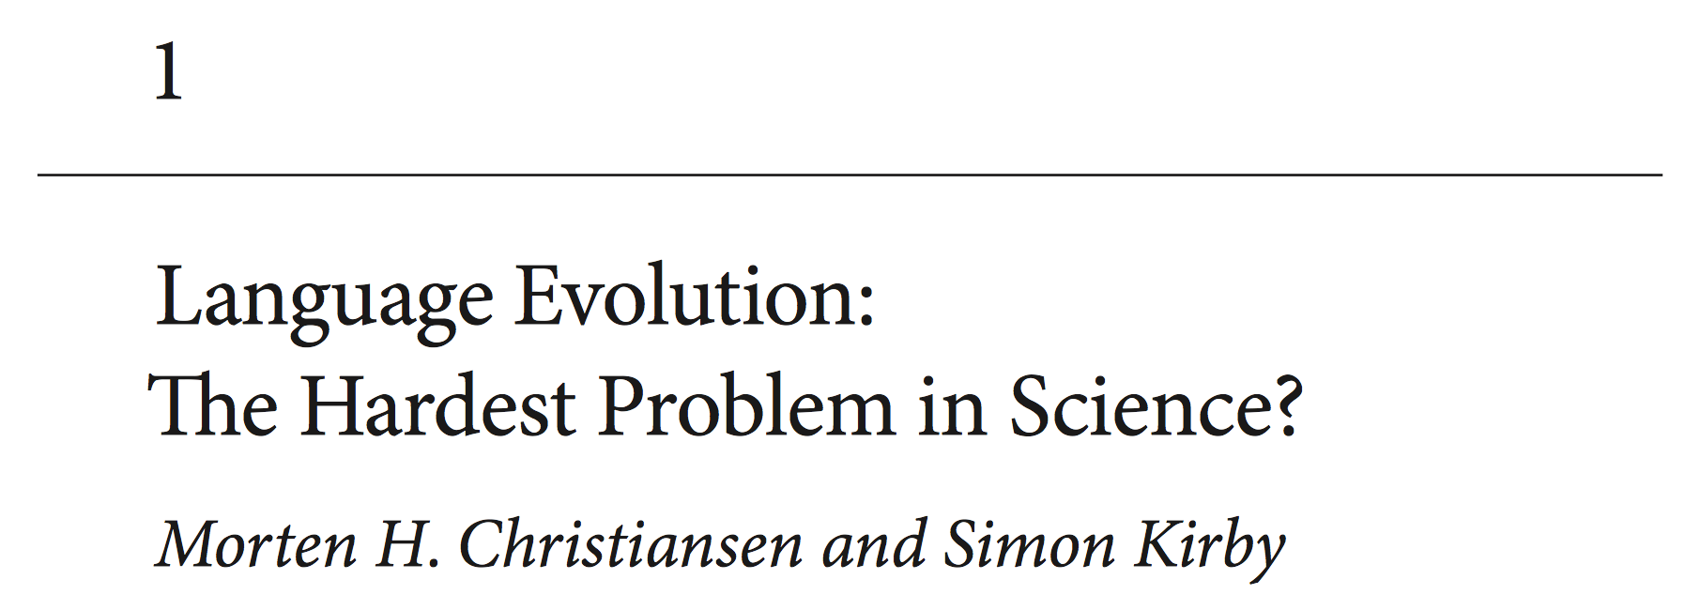
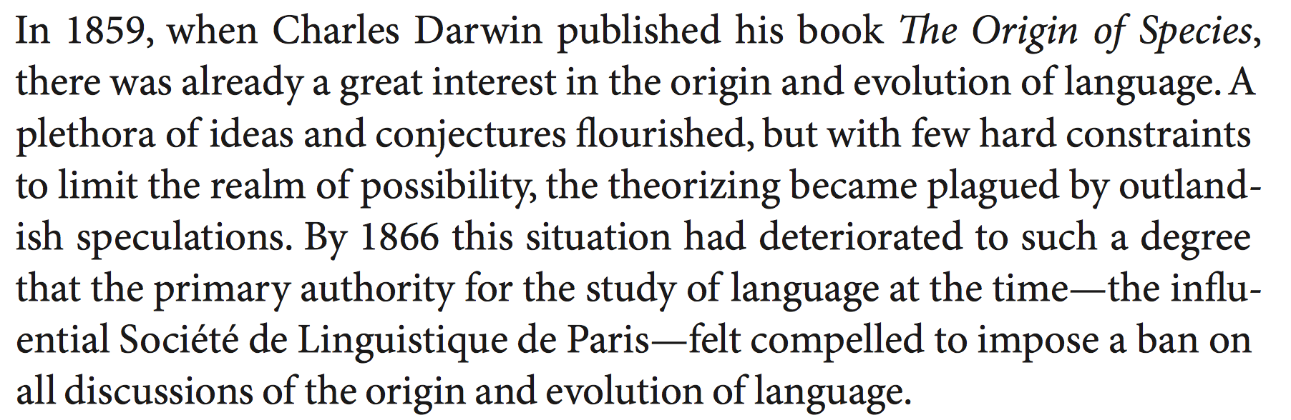
Motivations
Experimental diachronics
Why study language evolution?
Christiansen & Kirby (2003)

Slide 10
Methods
Experimental diachronics
How to study language evolution
https://startlediguana.files.wordpress.com/2013/10/boule_skulls.gif

Slide 11
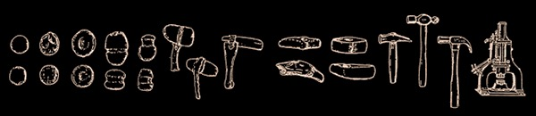
Methods
Experimental diachronics
How to study language evolution
Basalla (1988)

Slide 12
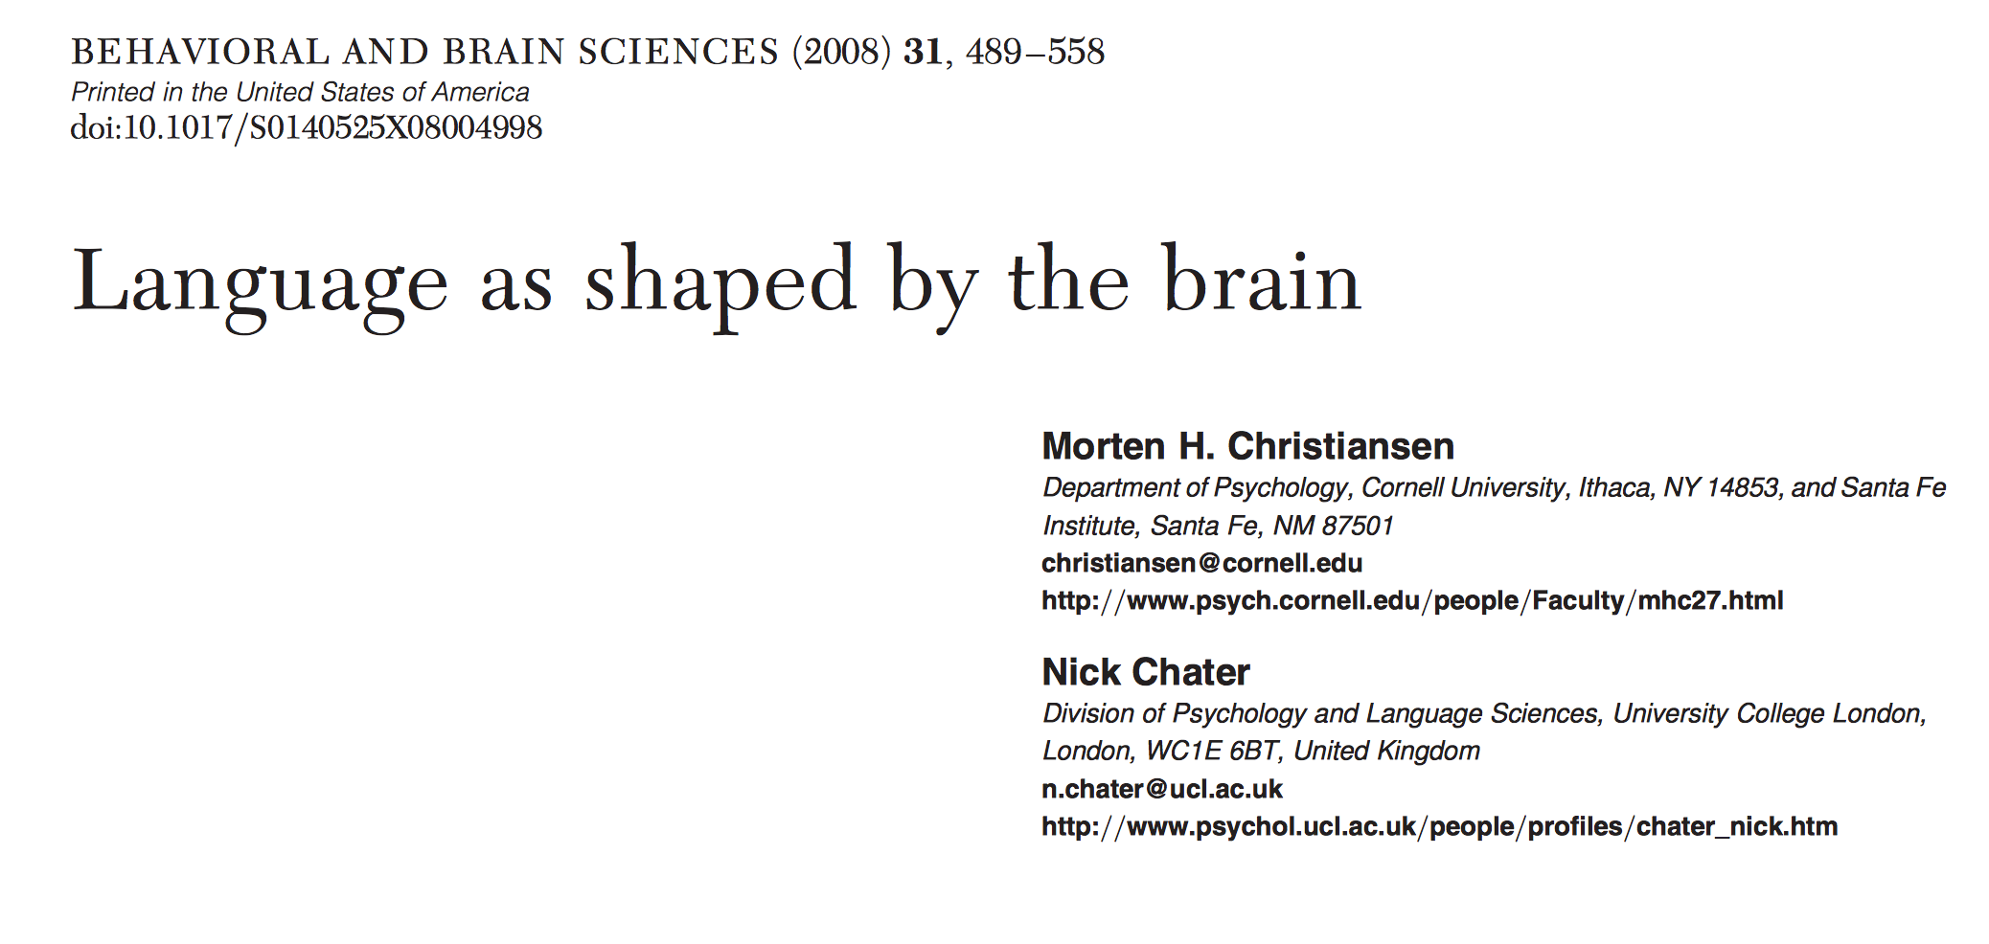
Methods
Experimental diachronics
How to study language evolution
Christiansen & Chater (2008)
Notes:
Evolution of cognition – leads to learning biases Learning biases shape culture

Slide 13
Methods
Experimental diachronics
How to study language evolution
Notes:
Evolution of cognition – leads to learning biases Learning biases shape culture

Slide 14
Methods
Experimental diachronics
How to study language evolution
1 8 5 0 3 7 6 2 4 9
Notes:
Evolution of cognition – leads to learning biases Learning biases shape culture

Slide 15
Methods
Experimental diachronics
How to study language evolution
Notes:
Evolution of cognition – leads to learning biases Learning biases shape culture

Slide 16
Methods
Experimental diachronics
How to study language evolution
0 1 2 3 4 5 6 7 8 9
Notes:
Evolution of cognition – leads to learning biases Learning biases shape culture

Slide 17
Methods
Experimental diachronics
How to study language evolution
Notes:
Evolution of cognition – leads to learning biases Learning biases shape culture

Slide 18
Methods
Experimental diachronics
How to study language evolution
icuetfsogrisoslimsncmhlou
Notes:
Evolution of cognition – leads to learning biases Learning biases shape culture

Slide 19
Methods
Experimental diachronics
How to study language evolution
Notes:
Evolution of cognition – leads to learning biases Learning biases shape culture

Slide 20
Methods
Experimental diachronics
How to study language evolution
summerschooloflinguistics
Notes:
Evolution of cognition – leads to learning biases Learning biases shape culture

Slide 21
Methods
Experimental diachronics
How to study language evolution
Notes:
Evolution of cognition – leads to learning biases Learning biases shape culture

Slide 22
Methods
Experimental diachronics
How to study language evolution
http://www.replicatedtypo.com/iterated-learning-using-youtube-videos/6093.html
Notes:
Evolution of cognition – leads to learning biases Learning biases shape culture

Slide 23
Methods
Experimental diachronics
How to study language evolution
Arrival (2016)
Notes:
Evolution of cognition – leads to learning biases Learning biases shape culture

Slide 24
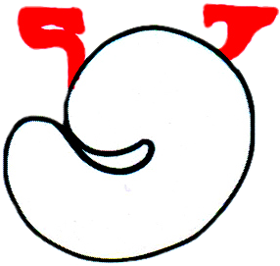


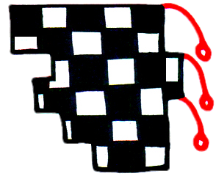
Methods
Experimental diachronics
How to study language evolution
gahemi
hekipo
kilonu
lenoga
Brand & Monaghan (in prep)
Notes:
Evolution of cognition – leads to learning biases Learning biases shape culture

Slide 25
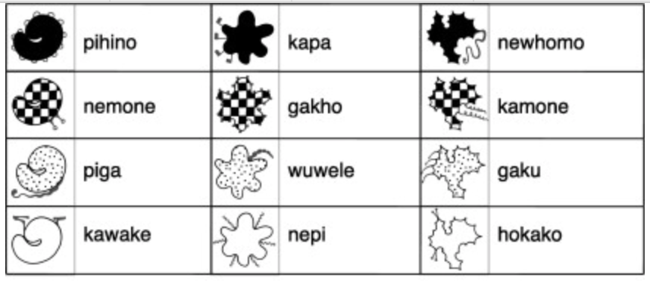
Methods
Experimental diachronics
How to study language evolution
Generation 1
Kirby, Tamariz, Cornish & Smith (2015)
Notes:
Evolution of cognition – leads to learning biases Learning biases shape culture

Slide 26
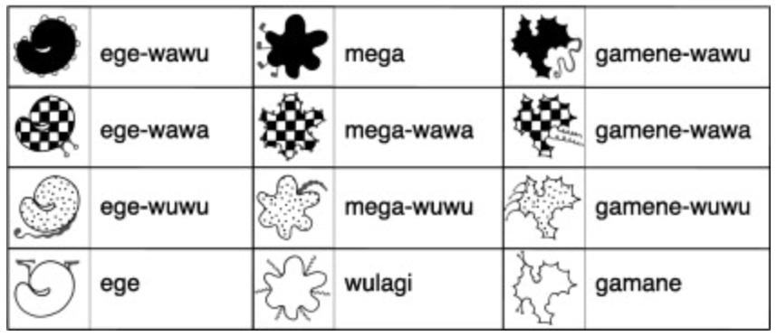
Methods
Experimental diachronics
How to study language evolution
Generation 10
Kirby, Tamariz, Cornish & Smith (2015)
Notes:
Evolution of cognition – leads to learning biases Learning biases shape culture

Slide 27
Methods
Experimental diachronics
How to study language evolution
Fehér et al (2017)
Notes:
Evolution of cognition – leads to learning biases Learning biases shape culture

Slide 28
Methods
Experimental diachronics
How to study language evolution
Claidière et al (2014)
Notes:
Evolution of cognition – leads to learning biases Learning biases shape culture

Slide 29
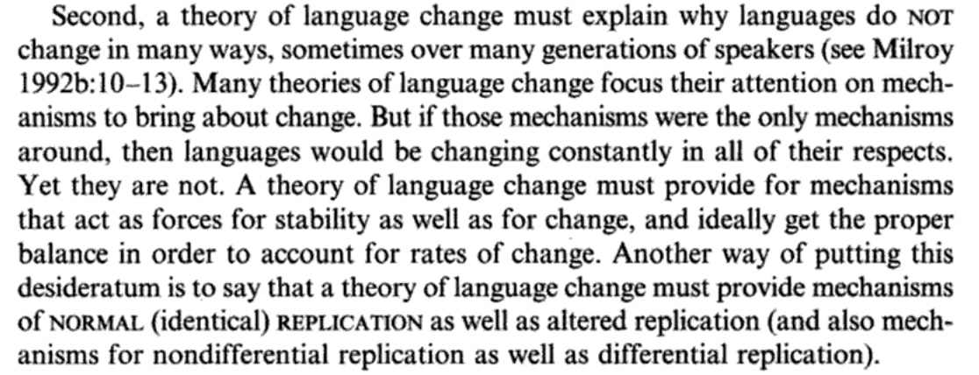
Findings
Experimental diachronics
Understanding why words change
Croft (2000, p.4)
Notes:
Evolution of cognition – leads to learning biases Learning biases shape culture

Slide 30
Findings
Experimental diachronics
Understanding why words change
mum
μαμά
mama
maman
mamá
butterfly
Πεταλούδα
schmetterling
papillon
mariposa
Notes:
Evolution of cognition – leads to learning biases Learning biases shape culture

Slide 31
Findings
Experimental diachronics
Understanding why words change
Ic ne secge
(Beowolf, 900)
Ic ne sege noht
(Ormulum, 1100)
I seye not
(Chaucer, 1400)
I doe not say
(Shakespeare, 1600)
I don’t say
(Woolf, 1900)
Dukelow (2017), Newberry (2017)
Notes:
Evolution of cognition – leads to learning biases Learning biases shape culture

Slide 32
Findings
Experimental diachronics
Understanding why words change
Notes:
Evolution of cognition – leads to learning biases Learning biases shape culture

Slide 33
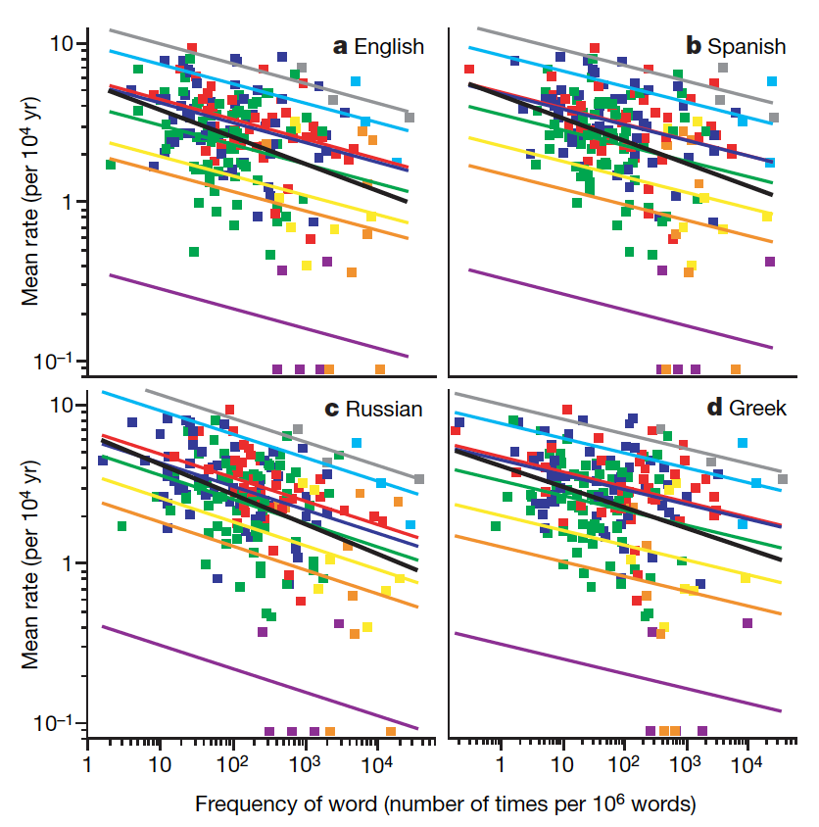
Findings
Experimental diachronics
Understanding why words change
Pagel, Atkinson & Meade (2007)
Notes:
Evolution of cognition – leads to learning biases Learning biases shape culture

Slide 34
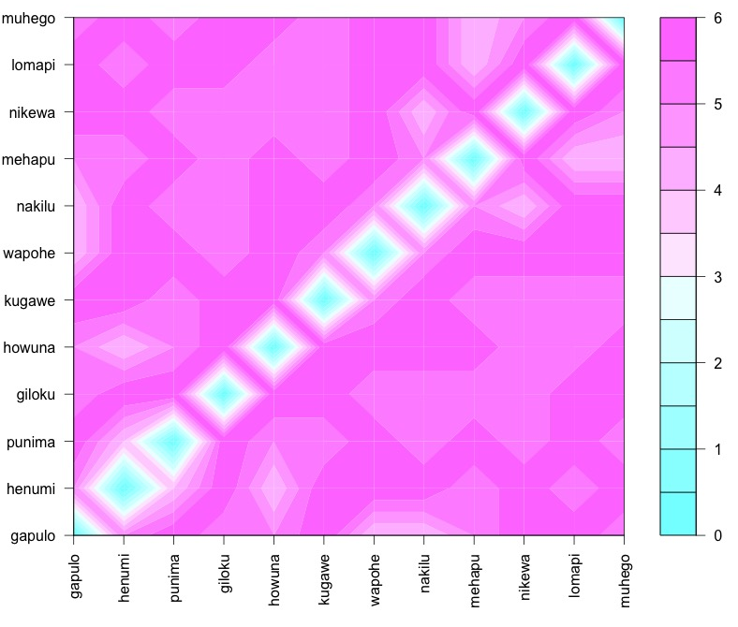
Findings
Experimental diachronics
Understanding why words change
Notes:
Evolution of cognition – leads to learning biases Learning biases shape culture

Slide 35
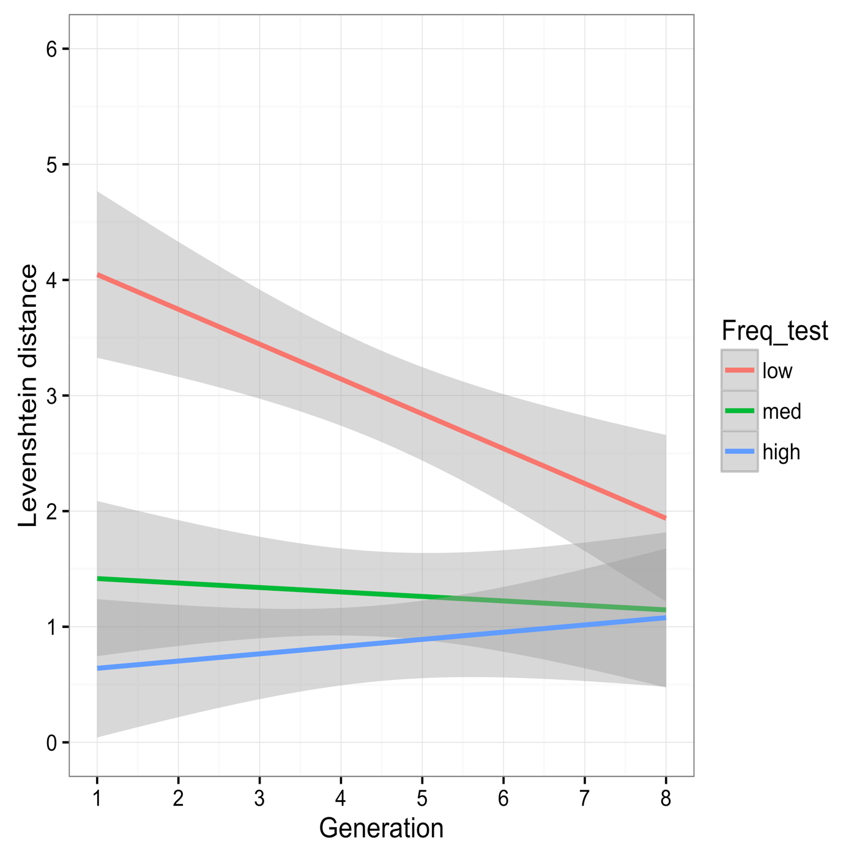
Findings
Experimental diachronics
Understanding why words change
Frequency | Generation 1 | Generation 7
low | giloku | mihewu
low | howuna | mihuge
low | kugawe | napiwa
low | lomapi | nokiwa
med | nakilu | lilipe
med | wapohe | lamupo
med | muhego | hewino
med | punima | wopehu
high | henumi | punima
high | gakulo | logopi
high | nipewa | henumi
high | mehapu | gakulo
Brand & Monaghan (in prep)
Notes:
Evolution of cognition – leads to learning biases Learning biases shape culture

Slide 36
Findings
Experimental diachronics
Understanding why words change
Word length
Semantics
Age of acquisition
Grammatical categories
Notes:
Evolution of cognition – leads to learning biases Learning biases shape culture

Slide 37
Findings
Experimental diachronics
Conclusions
What you have learnt today:
What language change and evolution is
Why we study it
How to study it
What studying it has shown us
Why multi-disciplinary research is important
Notes:
Evolution of cognition – leads to learning biases Learning biases shape culture

Slide 38
Questions/ ?
j.brand@lancaster.ac.uk
Notes:
Evolution of cognition – leads to learning biases Learning biases shape culture

Slide 39
Further reading
Croft, W. (2000). Explaining language change: An evolutionary approach. Pearson Education.
Christiansen, M. H., & Kirby, S. (Eds.). (2003). Language evolution. OUP Oxford.
Christiansen, M. H., & Chater, N. (2008). Language as shaped by the brain. Behavioral and brain sciences, 31(5), 489-509.
Darwin, C. (1888). The descent of man and selection in relation to sex (Vol. 1). Murray.
Fehér, O., Ljubičić, I., Suzuki, K., Okanoya, K., & Tchernichovski, O. (2017). Statistical learning in songbirds: from self-tutoring to song culture. Phil. Trans. R. Soc. B, 372(1711), 20160053.
Kirby, S., Tamariz, M., Cornish, H., & Smith, K. (2015). Compression and communication in the cultural evolution of linguistic structure. Cognition, 141, 87-102.
Pagel, M., Atkinson, Q. D., & Meade, A. (2007). Frequency of word-use predicts rates of lexical evolution throughout Indo-European history. Nature, 449(7163), 717.
Notes:
Evolution of cognition – leads to learning biases Learning biases shape culture

